Slide 1
Basic Altium Workshop
Friday, March 9th, 2007
HKN
Justin Migacz & Brandon Gilles

Slide 2
Why do a PCB?
PCBs are pretty cheap
  $33 for 2-layer boards from www.4pcb.com
Compact and Robust
Signal speed and reduced noise.
Why not?
Design is constantly being modified.
  Wire wraps
Harder to rework.

Slide 3
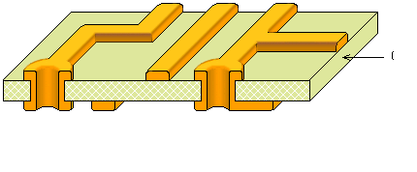
Board Makeup
1/16th inch FR4 epoxy substrate.
1 oz copper traces and plated Vias.

Slide 4
Project Makeup?
Schematic Design
  Label and connect parts.
PCB Layout
  Arrange physical components.
  Lay down the tracks.
Gerber Files
  Convention on how manufacturer will render your design.
Advanced Techniques:
  Signal Integrity Analysis.
  Spice simulations.

Slide 5
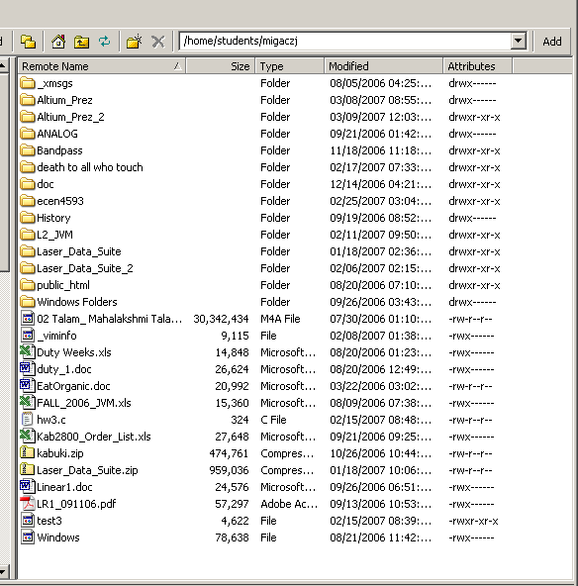
Retrieve Project from SSH:
/home/students/migaczj/Altium_Prez_2/Laser_Control_start

Slide 6
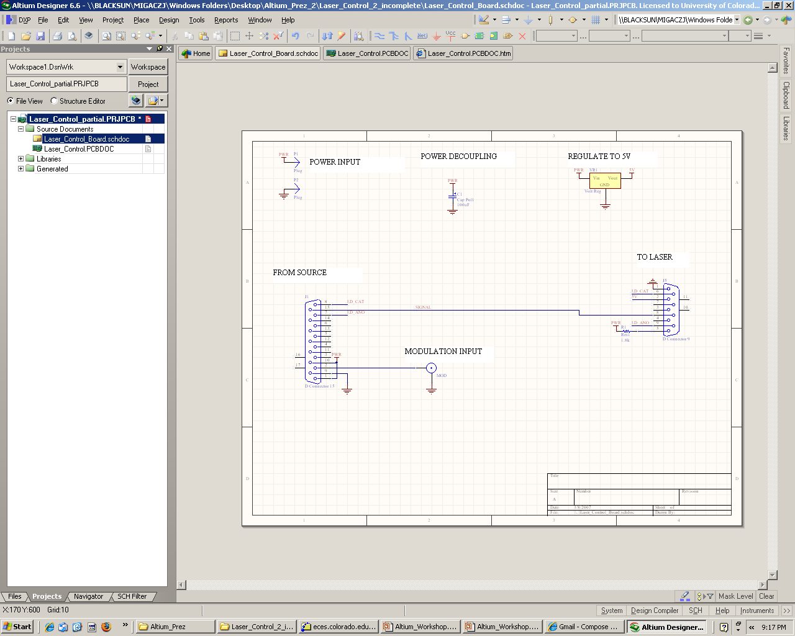
Schematic: Laser Control Board

Slide 7
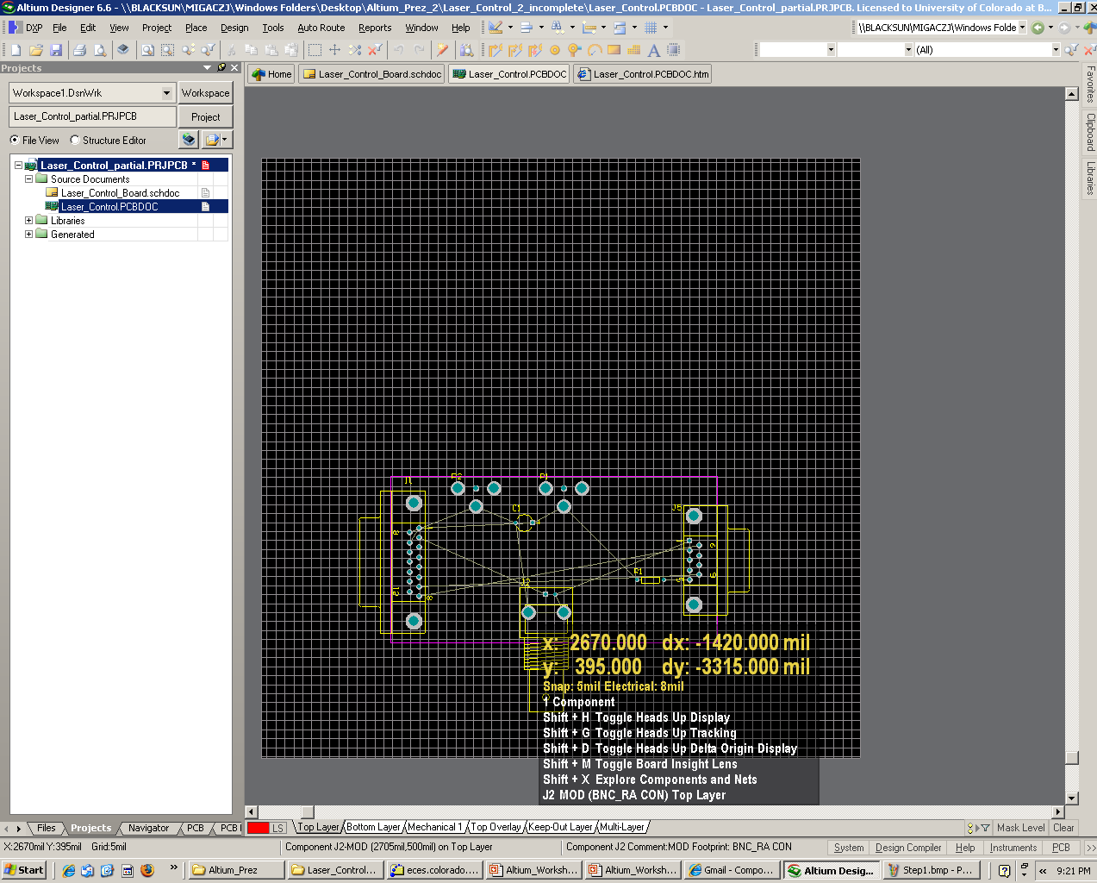
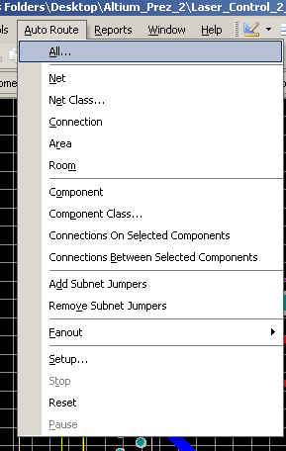
Step 1: PCB - Auto Route

Slide 8
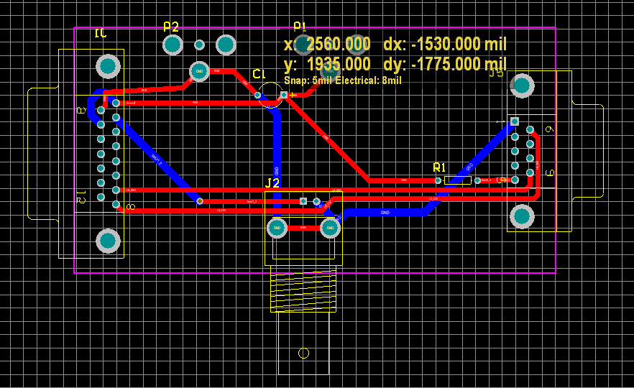
Step 1: PCB - Auto Route

Slide 9
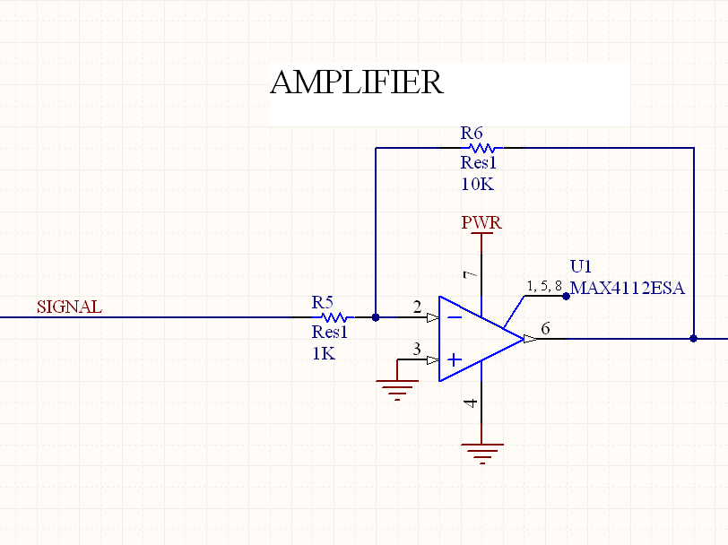
Step 2: Schematic - Add Amplifier

Slide 10
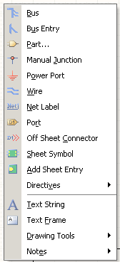
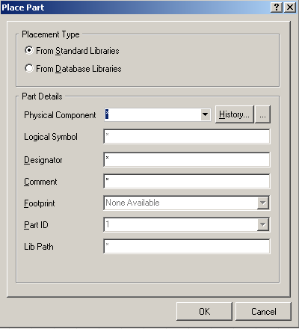
Step 2: Schematic – Placing Components
Place Part (P, P)

Slide 11
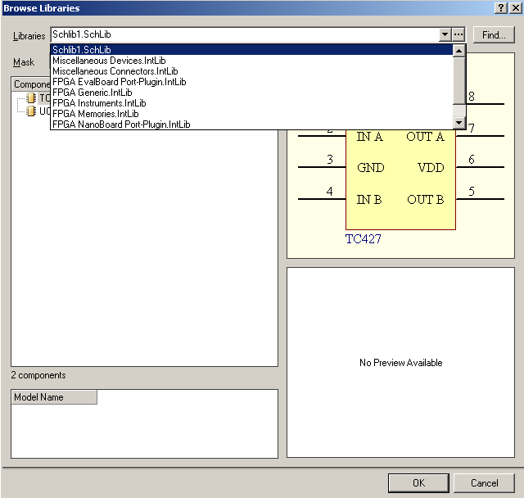
Step 2: Schematic
Additional Libraries

Slide 12
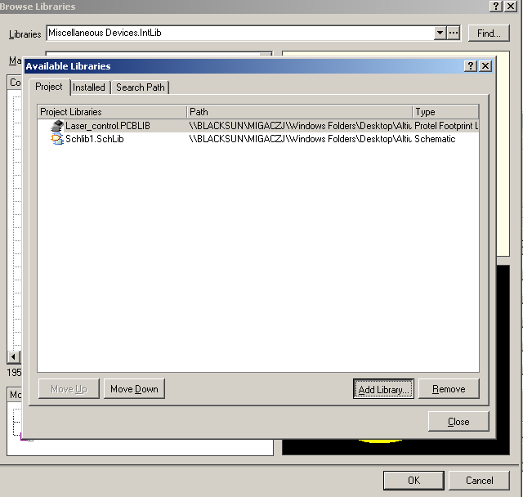
Step 2: Schematic – Adding Libraries
Add Library -> Maxim/Maxim Operational Amplifiers.IntLib

Slide 13
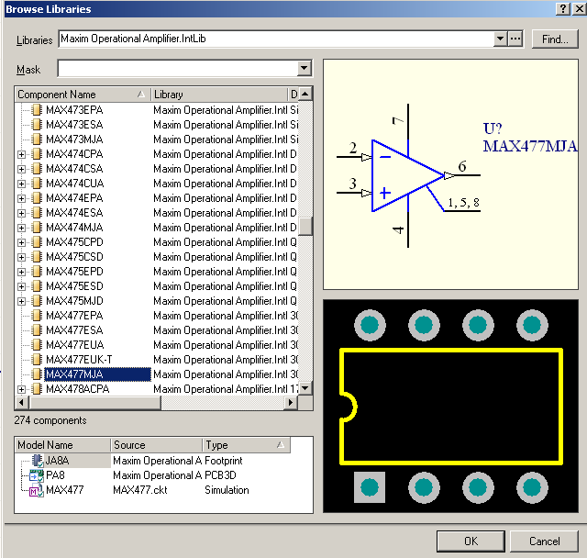
Step 2: Schematic - Add Amplifier
Choose MAX477MJA

Slide 14
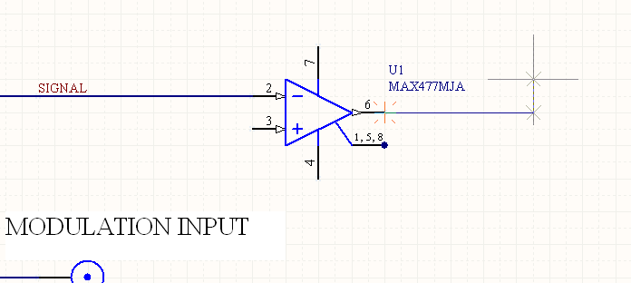
Step 2: Schematic
Place Wire (P, W)

Slide 15
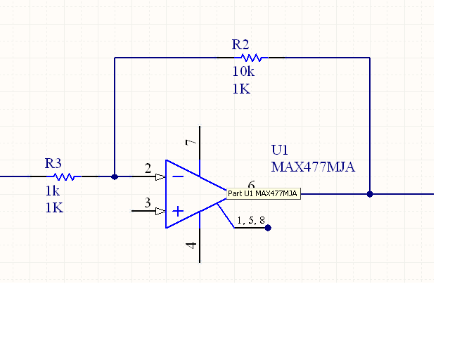
Step 2: Schematic
Place Resistors (P, P)

Slide 16
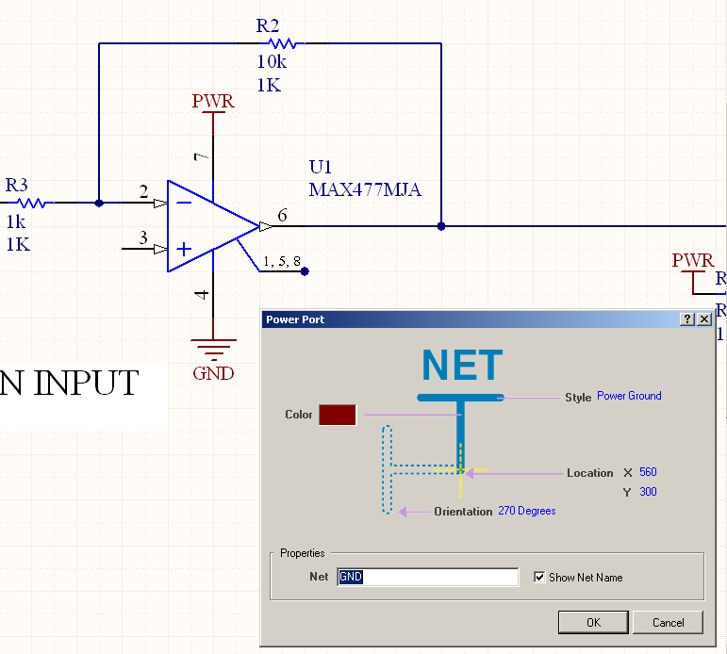
Step 2: Schematic
Add Power Objects (P, O, Tab)

Slide 17
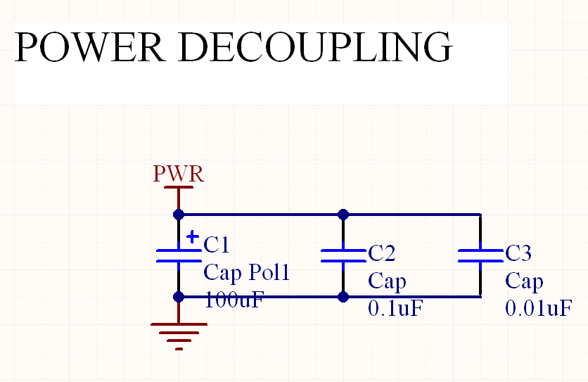
Step 2: Schematic
Add Decoupling Capacitors

Slide 18
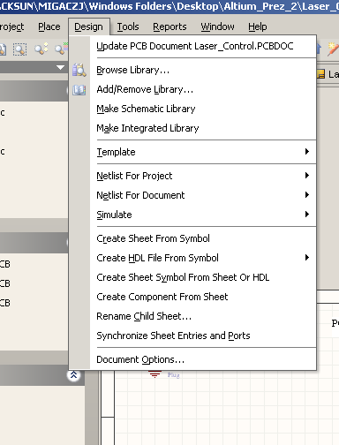
Step 2: Schematic
Update PCB with Changes

Slide 19
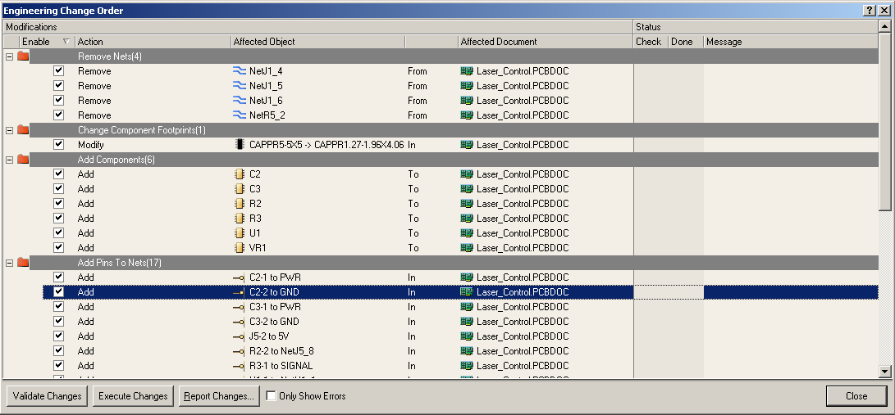
Step 2: Schematic
ECO (Engineering Change Order): Press “Execute Changes”

Slide 20
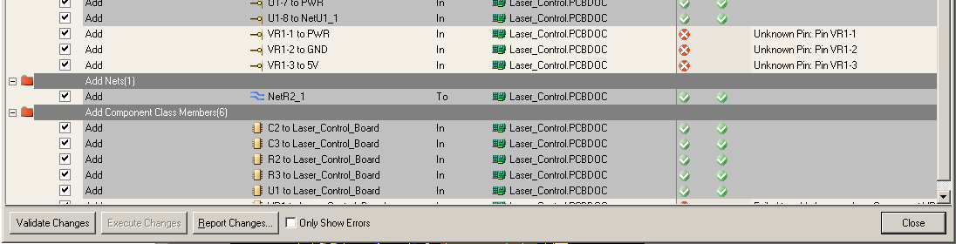
Step 2: Schematic
Sometimes Failures Happen: Correct Them don’t avoid them

Slide 21
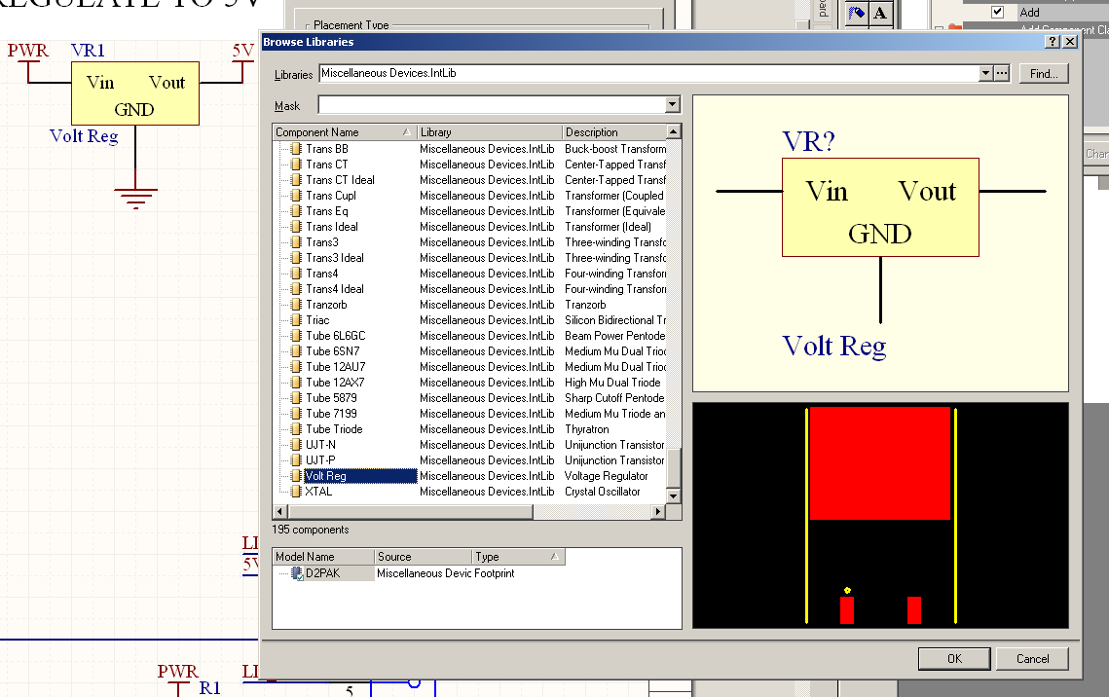
Step 2: Schematic
Switch out the voltage regulator

Slide 22
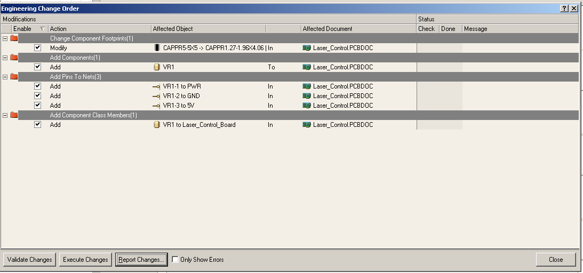
Step 2: Schematic
Re-Update PCB with Changes

Slide 23
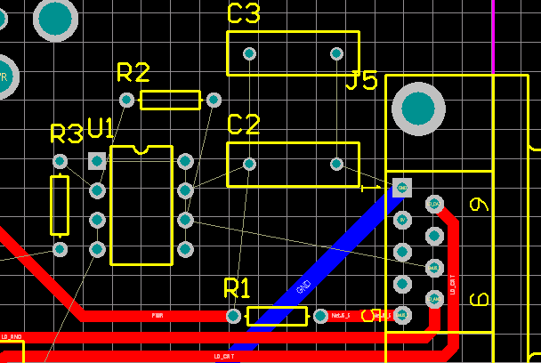
Step 3: PCB – Arranging Components
Use space bar to rotate

Slide 24
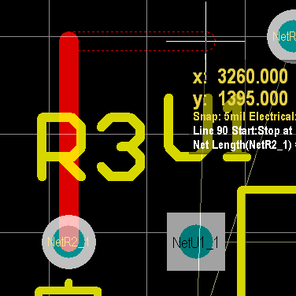
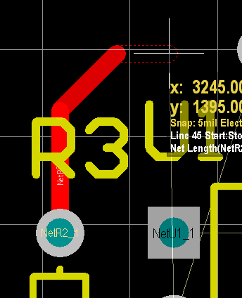
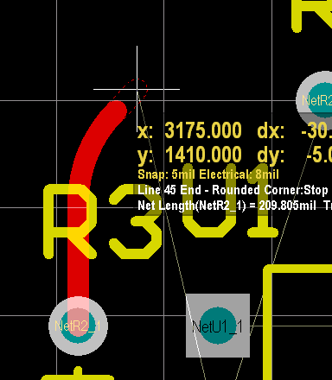
Step 3: PCB – Placing Tracks
Place Tracks (P, T)
Change Start Angle (Space)
Change Style (Shift-Space)
Remove Last Placement (Backspace)
Escape Action (Right Click)

Slide 25
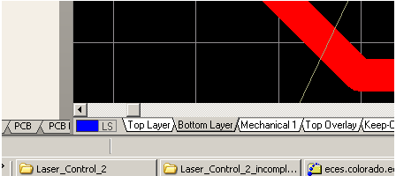
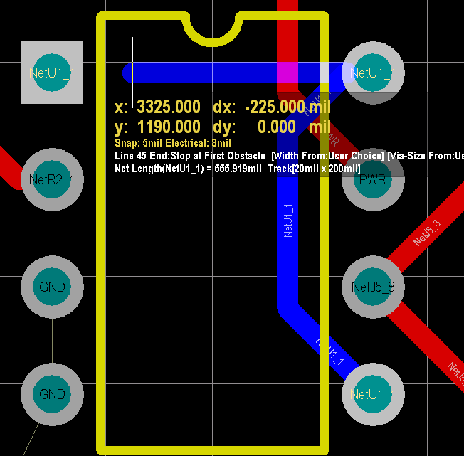
Step 3: PCB – Bottom Layer Routing
Grab the “Bottom Layer” tab on the bottom of the panel

Slide 26
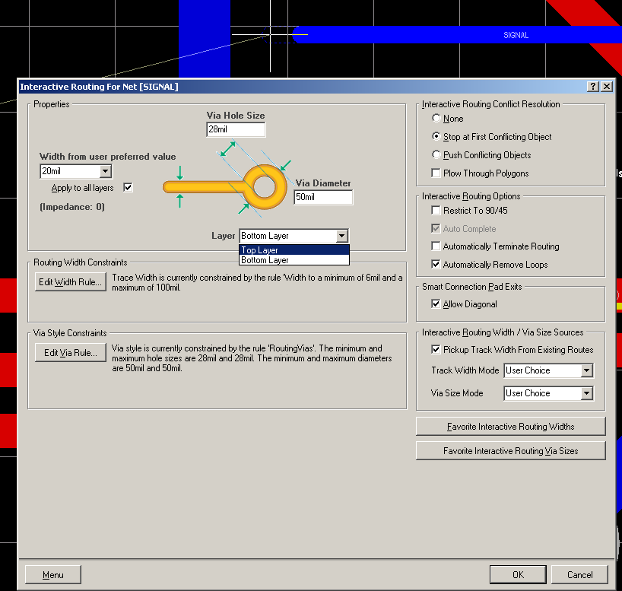
Step 3: PCB – Jumping Layers w/ Vias
Place Track (P, T)
Then edit while placing (Tab)
You can change the size on the fly

Slide 27
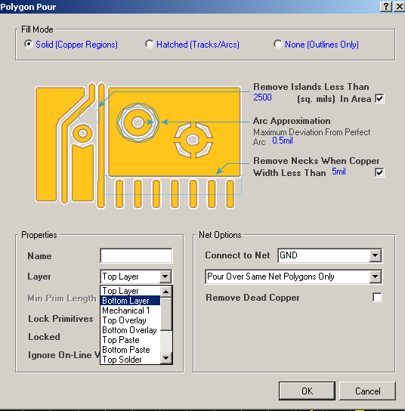
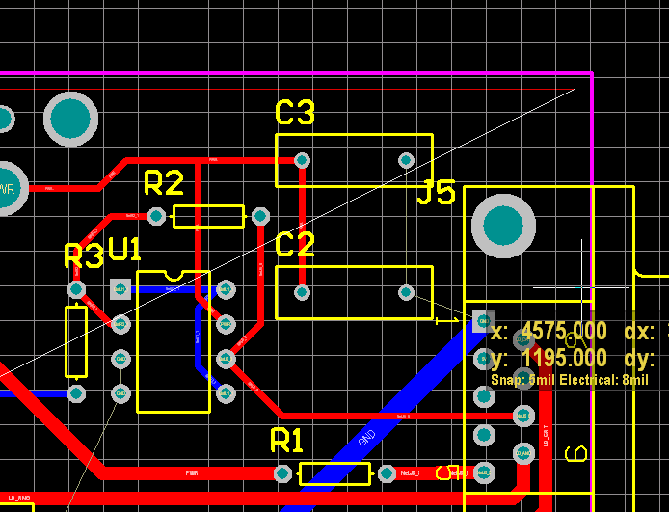
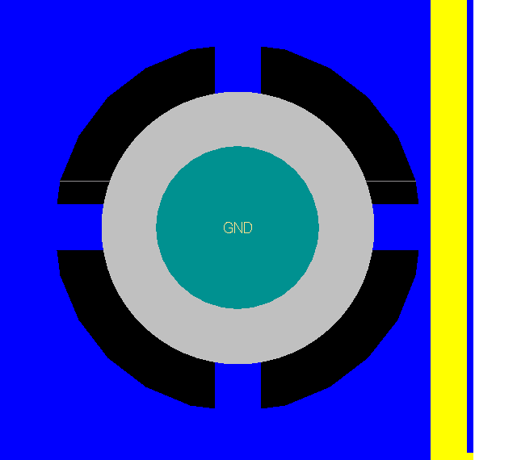
Step 3: PCB – Placing Polygon Planes (P, G)
Define the Net + Layer
Define the Vertices
It will automatically connect the Net

Slide 28
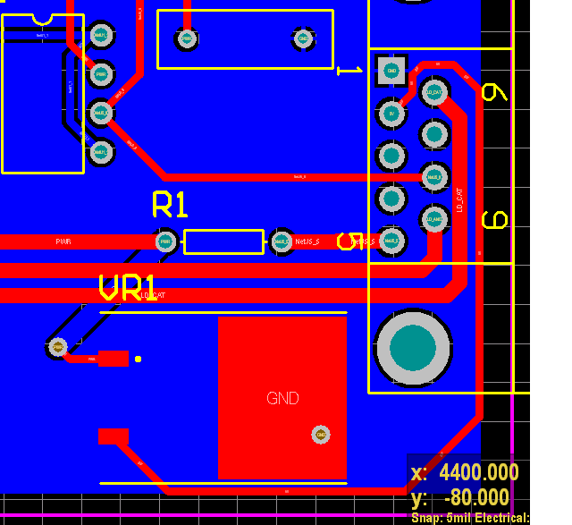
Step 3: PCB – Place Voltage Regulator
Move Polygon away temporarily

Slide 29
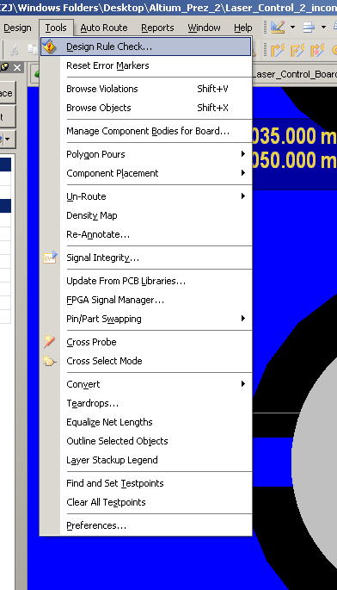
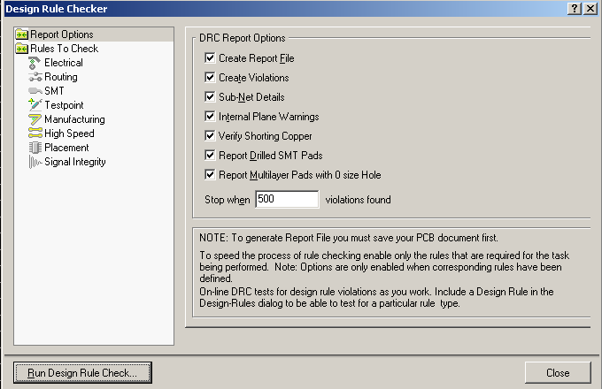
Step 3: Check Design Rules
Tools > Design Rule Check

Slide 30
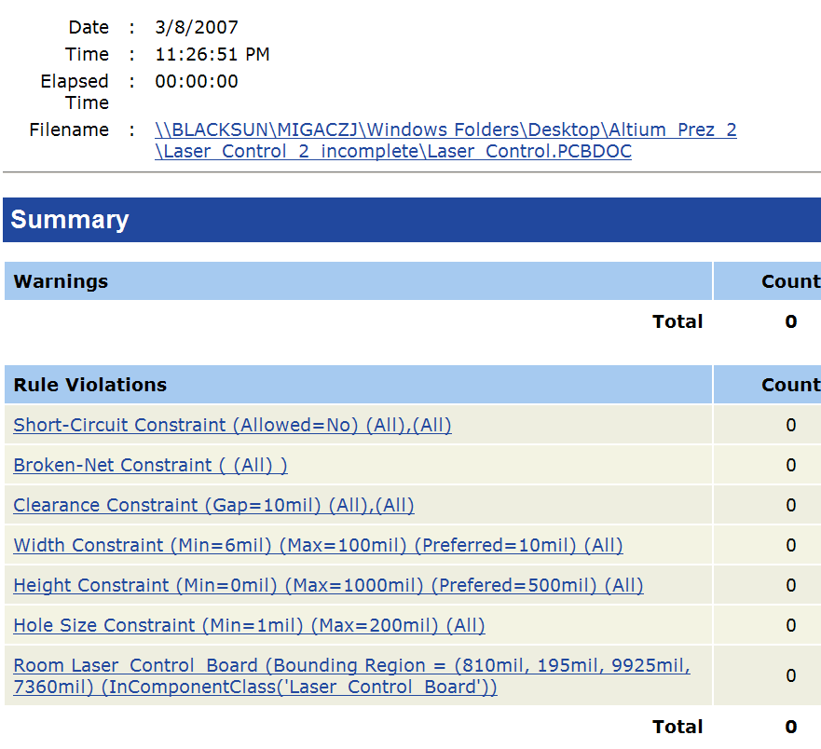
Step 3: PCB – No Errors! Yeah!

Slide 31
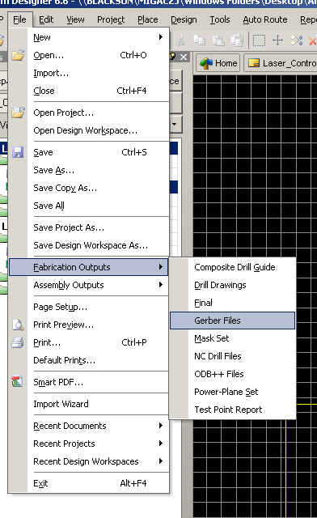
Step 4: PCB – Gerber File Generation
From PCB Document: File > Fabrication Outputs > Gerber Files

Slide 32
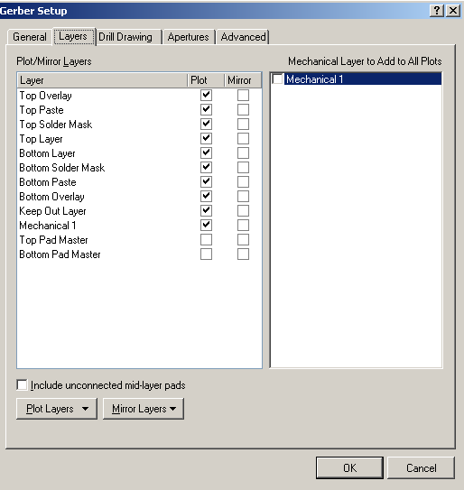
Step 4: PCB – Gerber File Generation
Make sure the important Layers are plotted
- Do not add “Mechanical Layers to all Plots”
- Press OK and CAM File is generated

Slide 33
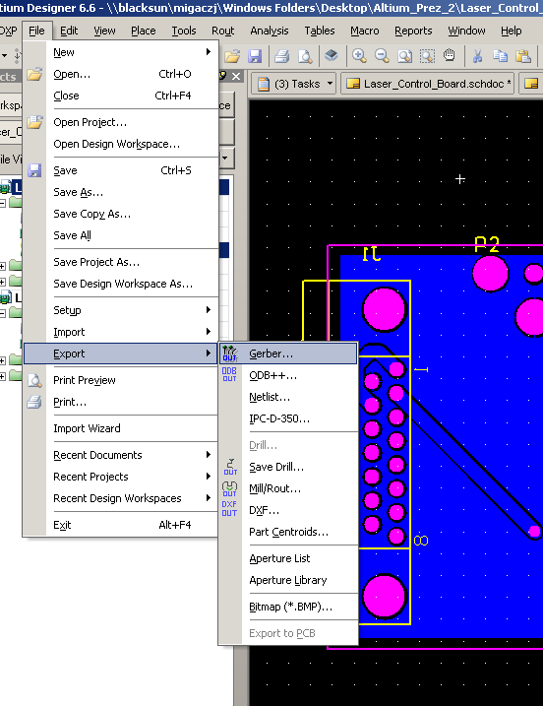
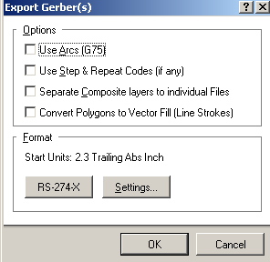
Step 4: PCB – Gerber File Generation
From the CAM File:
File > Export > Gerber > OK
Gerbers should be in Project Outputs in the project folder

Slide 34
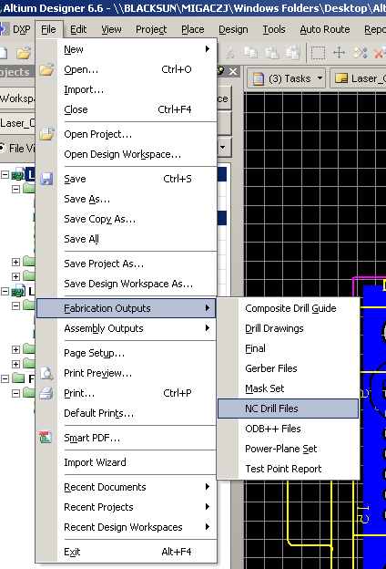
Step 4: PCB – NC Drill File Generation
Part 1:
Back in PCB Document:
- File > Fabrication Outputs > NC Drill
- Press OK in new window

Slide 35
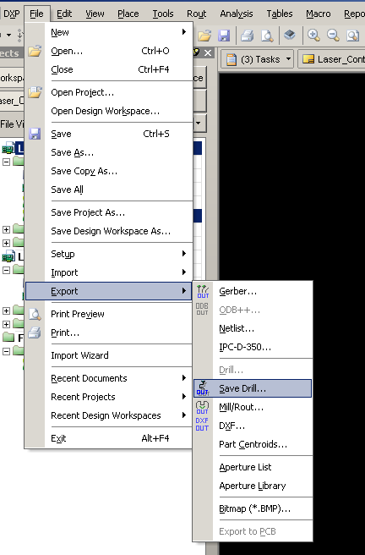
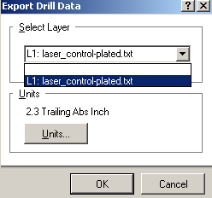
Step 4: PCB – NC Drill File Generation
Part 2:
In new CAM File (not the Gerber one):
- File > Expert > Save Drill
- Select the text File

Slide 36
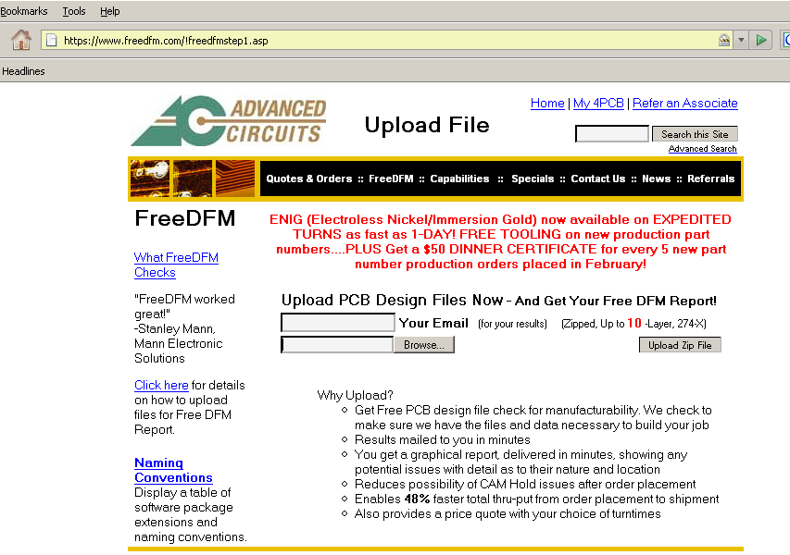
Step 5: PCB – Submit to Advanced Circuits
1. Compress the “Project Outputs” file into a .zip format
- We’ve included a zipped copy in your start folder: Outputs_Laser_Control.zip
2. Go to freedfm.com, Upload the ZIP file

Slide 37
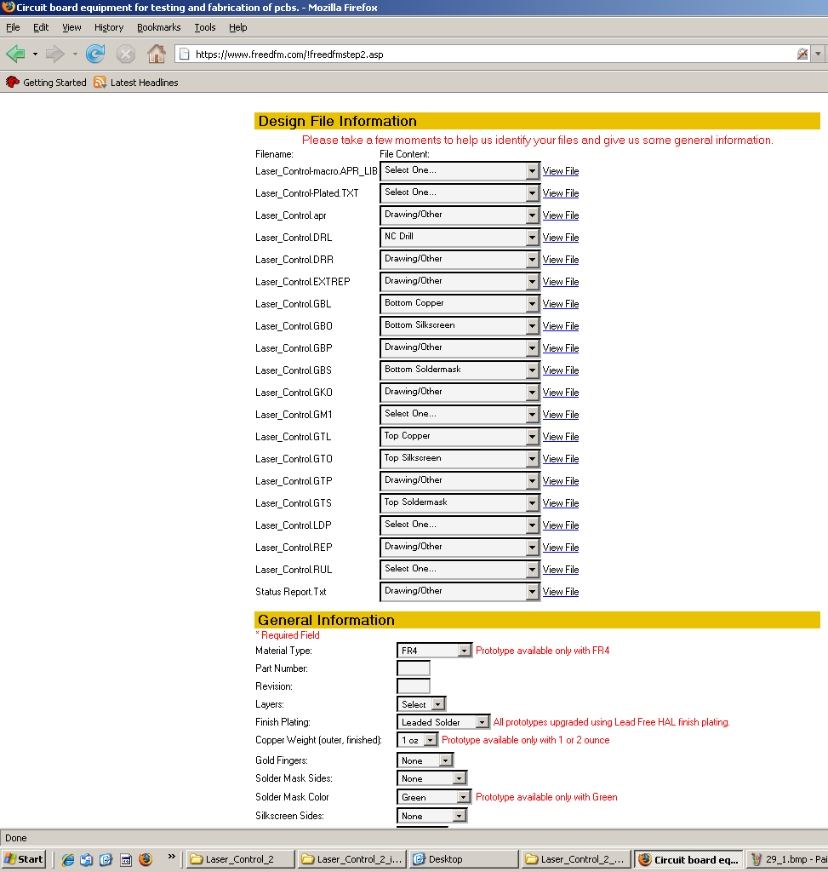
Step 5: PCB – Submit to Advanced Circuits
Fill in the Form
  Replace “Select One… ” with “Drawing Other”

Slide 38
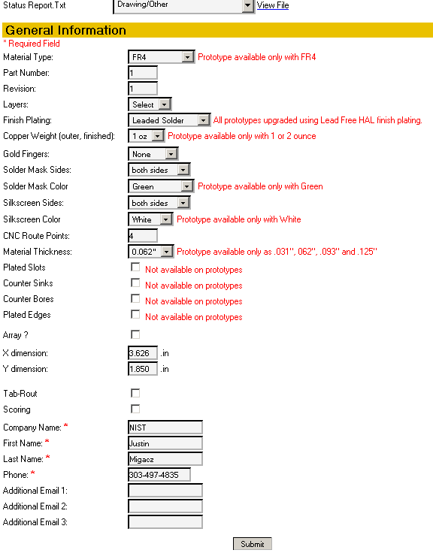
Step 5: PCB – Submit to Advanced Circuits
Make “Solder Mask Sides” -> Both Sides
Make “Silkscreen Sides” -> Both Sides
Find Board Size -> Go Back to Project

Slide 39

Additional Questions?
Ask about specific tasks you want to accomplish.

